Slide 1
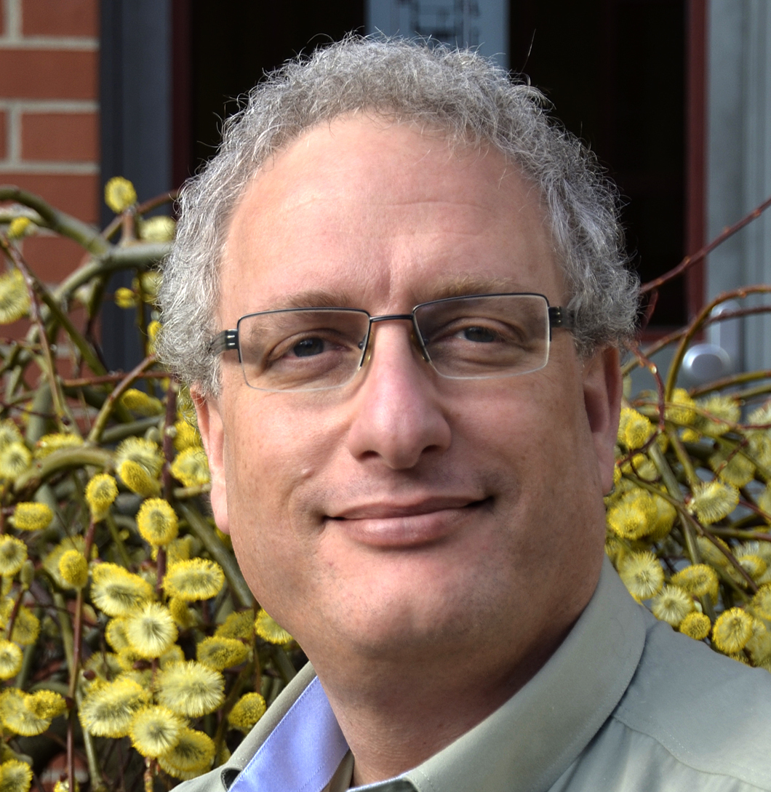
专家学术报告
Group 4 Complexes in the Homopolymerization, Copolymerization and Design of Polyolefins
Prof. Moris S. Eisen
Isreal Institute of Technology
2016年9月14日（星期三）
上午9:00-10:00
材料学院A405
He got his Ph.D. in 1990from Hebrew University of Jerusalem, Israel. After a Postdoc at Northwestern University, he started his research career at Technion, Isreal Institute of Technology, where he is currently the Dean of Students. He has won many award through his career, including Alexander v. Humboldt Research Prize, Henry Taub Research Prize Award and many others. He has published over 170 papers and given over 250 presented talks.
主办单位: 东华大学 材料科学与工程学院

