Slide 1
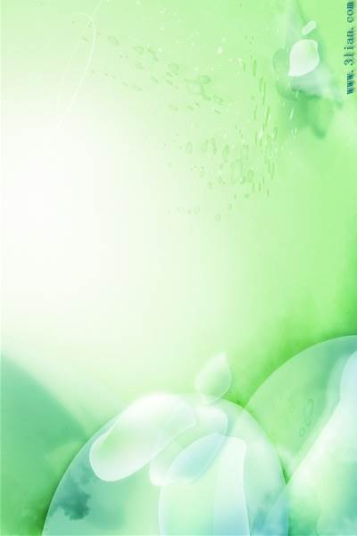
学术报告
Low Cost Materials for High Energy Sodium-ion Battery
报 告 人：侴术雷 高级研究员
工作单位：Wollongong大学
个人简介：
2010年在澳大利亚Wollongong大学获得博士学位。主要工作集中在新能源材料的研发。发表文章100余篇其中包括Science, Nature Communications, Nano Letters, Advanced Materials, Chemistry of Materials等一流期刊。文章被他引超过4000次，h因子超过33。其中有18篇被列为ESI高被引文章。科研经费总计超过1500万澳元。获得奖励包括，2014 Scopus澳大利亚年轻科学家奖 (工程技术类), 2012年法国-澳大利亚科学创新合作项目青年学者基金，第63届国际电化学会年会青年电化学家旅行奖金，2010年度优秀博士论文奖，澳大利亚研究委员会国家博士后基金等。指导博士生18人（其中7人已毕业）。
报告摘要：
Sodium-ion battery is a low cost energy storage device, which are similar in some ways to lithium-ion batteries. In both systems, Na/Li ions are shuttled between the battery’s positive and negative electrodes during charging and discharging. Taking into account recent concerns about a possible lithium shortage with the spread of electric vehicles, it is urgent to search for alternative energy storage systems that could complement the existing Li-ion technology. For this purpose, Na-ion technology can be a suitable choice in terms of battery cost, safety, and raw material abundance. Due to the increased size and heavier weight of the Na atom compared to the Li atom, the volumetric energy density and specific energy density obtainable for the sodium-ion battery would be less than those obtainable with the lithium-ion battery. However, Na-ion batteries would be interesting for very low cost systems for grid storage, which could make renewable energy a primary source of energy rather than just a supplemental one. Here, we will present our work on both anode and cathode materials for sodium ion battery. The anode materials include carbon based materials, Sn-based materials and red phosphorous based composites with high specific capacity and excellent capacity retention. Cathode materials will be focus on the low-cost Prussian blue materials.
时间：2016年11月3日（周四）
下午16:00
地点：材料学院C321
东华大学材料科学与工程学院
纤维材料改性国家重点实验室

